Slide 1

Machine Learning & Data Mining CS/CNS/EE 155
Lecture 7:
Recap of CRFs & Structural SVMs

Slide 2
Announcements
Homework 2 due in ~1 week
Discussion Forums on Moodle
Homework 3 released in ~1 week
Will be easier than HW2, but has 1 proof question.
First mini-project released in ~1 week
Kaggle competition that will run for 3 weeks.
You can work in groups of up to 3.

Slide 3
Today
Recap of Conditional Random Fields
Simpler notation
Harder to relate back to earlier lectures on HMMs
Easier to relate to more general structured prediction problems
I.e., beyond pairwise linear chain models
Introduction to Structural SVMs

Slide 4
Recap: Sequence Prediction
Input: x = (x¹,…,x^{M})
Predict: y = (y¹,…,y^{M})
Each y^{i} one of L labels.
x = “Fish Sleep”
y = (N, V)
x = “The Dog Ate My Homework”
y = (D, N, V, D, N)
x = “The Fox Jumped Over The Fence”
y = (D, N, V, P, D, N)
POS Tags:
Det, Noun, Verb, Adj, Adv, Prep
L=6

Slide 5
Recap: General Multiclass
x = “Fish sleep”
y = (N, V)
Multiclass prediction:
All possible length-M sequences as different class
(D, D), (D, N), (D, V), (D, Adj), (D, Adv), (D, Pr) (N, D), (N, N), (N, V), (N, Adj), (N, Adv), …
L^{M} classes!
Length 2: 6² = 36!
POS Tags:
Det, Noun, Verb, Adj, Adv, Prep
L=6
Can Model Everything!
(In Theory)
Exponential Explosion in #Classes!
(Not Tractable)

Slide 6
Recap: Independent Multiclass
x=“I fish often”
POS Tags:
Det, Noun, Verb, Adj, Adv, Prep
L=6
Treat each word independently (assumption)
Independent multiclass prediction per word
Predict for x=“I” independently
Predict for x=“fish” independently
Predict for x=“often” independently
Concatenate predictions.
#Classes = #POS Tags
(6 in our example)
Solvable using standard multiclass prediction.
But ignores context!
Assume pronouns are nouns for simplicity.

Slide 7
1st-Order Sequence Models
General multiclass:
Unique scoring function per entire seq.
Very intractable
Independent multiclass
Scoring function per token, apply to each token in seq.
Ignores context, low accuracy
First-order models
Scoring function per pair of tokens.
“Sweet spot” between fully general & ind. multiclass

Slide 8
1st-Order Sequence Model
Scoring Function
Scoring transitions
Scoring input features
x = “Fish Sleep”
Prediction:
 | u_{N,*} | u_{V,*}
u_{*,N} | -2 | 1
u_{*,V} | 2 | -2
u_{*,Start} | 1 | -1
 | w_{N,*} | w_{V,*}
w_{*,Fish} | 2 | 1
w_{*,Sleep} | 1 | 0
y | F(y,x)
(N,N) | 1+2-2+1 = 2
(N,V) | 1+2+2+0 = 4
(V,N) | -1+1+2+1 = 3
(V,V) | -1+1-2+0 = -1
w_{V,Fish}
u_{N,V}
y⁰ = special start state

Slide 9
New Notation
Duplicate word features for each label.
Noun
Class
Features
Verb
Class
Features

Slide 10
New Notation
One feature for every transition.

Slide 11
New Notation
Old Scoring
Function
Scoring transitions
Scoring input features
New Scoring
Function
Stacked
Weight Vector
Stacked
Feature Vector

Slide 12
Old Notation:
 | w_{N,*} | w_{V,*}
w_{*,Fish} | 2 | 1
w_{*,Sleep} | 1 | 0
Old Notation:
 | u_{N,*} | u_{V,*}
u_{*,N} | -2 | 1
u_{*,V} | 2 | -2
u_{*,Start} | 1 | -1

Slide 13
Why New Notation?
Easier to reason about:
Computing Predictions
Computing Gradients
Extensions (just generalize φ)

Slide 14
Conditional Random Fields

Slide 15
x = “Fish Sleep” y = (N,V)
( )
y | exp(F(y,x))
(N,N) | exp(2+1+1-2) = exp(2)
(N,V) | exp(2+1+0+1) = exp(4)
(V,N) | exp(1-1+1+2) = exp(3)
(V,V) | exp(1-1+0-2) = exp(-1)
Z(x) = Sum

Slide 16
Reduction to Independent Multiclass
Suppose:
Then:
No pairwise features.
Stack features ϕ₁(x^{j}) L times

Slide 17
Computing Predictions (Viterbi)
Maintain length-k
prefix solutions
Recursively solve for
length-(k+1) solutions
Predict via best
length-M solution

Slide 18
Solve:
Store each
Ŷ¹(T) & F(Ŷ¹(T),x)
Ŷ¹(V)
y¹=V
Ŷ²(V)
y¹=D
Ŷ¹(D)
Ŷ²(D)
y¹=N
Ŷ¹(N)
Ŷ²(N)
Ŷ¹(T) is just T

Slide 19
Solve:
Store each
Ŷ¹(T) & F(Ŷ¹(T),x)
Ŷ¹(V)
Ŷ²(V)
Ŷ¹(D)
Ŷ²(D)
y¹=N
Ŷ¹(N)
Ŷ²(N)
Ŷ¹(T) is just T
Ex: Ŷ²(V) = (N, V)

Slide 20
Solve:
Store each
Ŷ¹(T) & F(Ŷ¹(T),x)
Store each
Ŷ²(Z) & F(Ŷ²(Z),x)
Ŷ¹(V)
Ŷ²(V)
y²=V
Ŷ³(V)
y²=D
Ŷ¹(D)
Ŷ²(D)
Ŷ³(D)
y²=N
Ŷ¹(N)
Ŷ²(N)
Ŷ³(N)
Ŷ¹(Z) is just Z
Ex: Ŷ²(V) = (N, V)

Slide 21
Solve:
Store each
Ŷ¹(Z) & F(Ŷ¹(Z),x)
Store each
Ŷ²(T) & F(Ŷ²(T),x)
Store each
Ŷ³(T) & F(Ŷ³(T),x)
Ŷ¹(V)
Ŷ²(V)
Ŷ³(V)
Decomposes additively by
pairwise feature vector:
φ^{j}(a,b|x)
Easier to keep track of!
Ŷ^{L}(V)
…
Ŷ¹(D)
Ŷ²(D)
Ŷ³(D)
Ŷ^{L}(D)
Ŷ¹(N)
Ŷ²(N)
Ŷ³(N)
Ŷ^{L}(N)
Ŷ¹(T) is just T
Ex: Ŷ²(V) = (N, V)
Ex: Ŷ³(V) = (D,N,V)

Slide 22
Computing Conditional Probabilities
Matrix Notation:
Challenges:
Compute Z(x) efficiently
Numerical instability
See course notes.

Slide 23
Matrix Semiring
Matrix Version of G^{j}
G^{j}(a,b)
L+1
Include ‘Start’
L+1
G^{1:2}
=
G²
G¹
G^{i:j}
=
G^{j}
G^{j-1}
…
G^{i+1}
G^{i}
See course notes.

Slide 24
Computing Partition Function
Consider Length-1 (M=1)
M=2
General M
Do M matrix computations to compute G^{1:M}
Z(x) = sum column ‘Start’ of G^{1:M}
Sum column ‘Start’ of G¹!
Sum column ‘Start’ of G^{1:2}!
Sum column ‘Start’ of G^{1:M}!
G^{1:M}
=
G^{M}
G^{M-1}
…
G²
G¹
See course notes for more efficient approach.

Slide 25
Dealing w/ Numerical Instability
Previous slide suffers from numerical instability
G^{1:k} can easily overflow and/or underflow
Numerical Stability va Scaling:
Example Scaling Factor:
Use log probs instead!
See course notes.

Slide 26
Training
Minimize log loss of training data:

Slide 27
Optimality Condition
Optimality condition:
Frequency counts = Cond. expectation on training data!
If each feature is disjoint, then above equality holds for each (a,b):

Slide 28
Computing P(y^{j}=a,y^{j}-1=b|x) (Forward-Backward)
Forward Computes
1st Sum Efficiently
Backward Computes
2nd Sum Efficiently
See course notes.

Slide 29
Forward-Backward for CRFs
See course notes.

Slide 30
Dealing w/ Numerical Instability
Numerical instability: α^{j} & β^{j} vectors can blow up
Observation:
New α^{j} & β^{j} vectors:
See course notes.

Slide 31
Recap: Conditional Random Fields
“Log-Linear” 1st order sequence models
Can compute conditional probabilities P(y|x)
Pairwise feature maps φ^{j}(a,b|x)
Arbitrary features that depend on pairs of labels.
Train via minimizing neg log likelihood
Dynamic programming to train and predict

Slide 32
Structural SVMs

Slide 33
1st Order Sequential Model
Linear in pairwise features φ^{j}(a,b|x):
Prediction via maximizing F:
How to train w?

Slide 34
CRF Learning Revisited
CRFs minimize log loss:
Reduces to independent Logistic Regression
When F only depends on single tokens at a time

Slide 35
Other Loss Functions?
General Form:
Log Loss:
0/1 Loss:
(But not all mis-predictions equally bad…)
True y = (D,N,V,D,N)
y’ = (D,N,V,N,N)
y” = (V,D,N,V,V)
Equal 0/1 Loss…
…but clearly y” is worse
Should have loss function that distinguishes between y’ and y”!

Slide 36
Hamming Loss
Hamming Loss:
True y = (D,N,V,D,N)
y’ = (D,N,V,N,N)
y” = (V,D,N,V,V)
(But not continuous!)
y” has much worse hamming loss
(loss of 5 vs loss of 1)
Need to define continuous surrogate of Hinge Loss!

Slide 37
Surrogates of Hamming Loss
Log Loss ≈ surrogate for Hamming Loss:
Suppose y & y’ differ by 1 token
Hamming loss differs by 1
Log Loss differs by two φ^{j}(a,b|x) terms
What about Hinge Loss?
Hinge Loss
Log Loss
Hamming Loss

Slide 38
Original Hinge Loss (Support Vector Machine)
Hinge Loss
Loss
Target y
0/1 Loss
f(x)

Slide 39
Property of Hinge Loss
➔
Hinge loss = continuous upper bound on 0/1 loss

Slide 40
Hamming Hinge Loss (Structural SVM)
Sometimes normalize by M
➔
➔
Learned Predictor
Continuous upper bound on Hamming Loss!

Slide 41
Hamming Hinge Loss
Suppose for incorrect y’=h(x_{i}):
Then:
Score(y_{i})
Score(y’)
Loss(y’)
Slack
Slack variable upper bounds Hamming Loss!

Slide 42
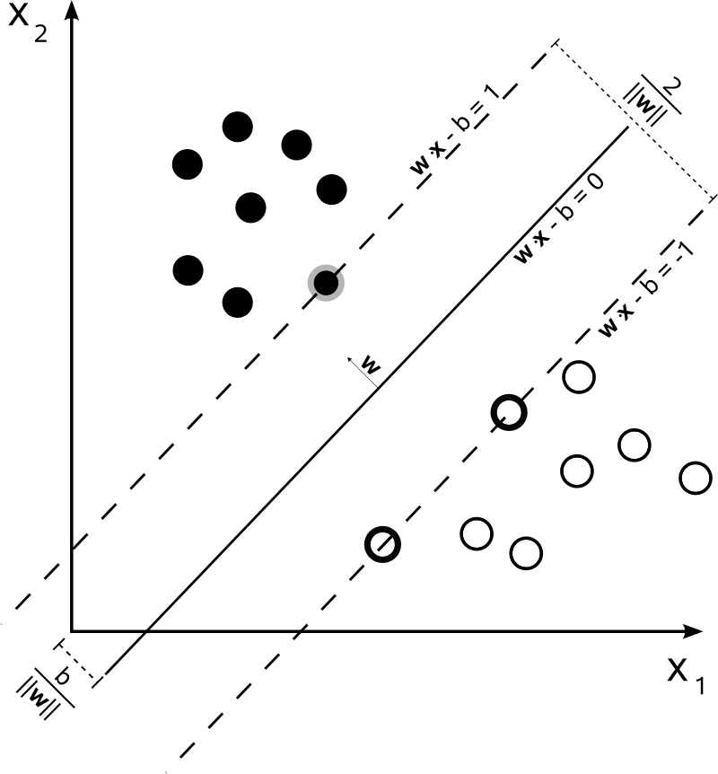
Recall: Soft-Margin Support Vector Machine
“Margin”
Size of Margin
vs
Size of Margin Violations
(C controls trade-off)
Image Source: http://en.wikipedia.org/wiki/Support_vector_machine

Slide 43
Soft-Margin Structural
Support Vector Machine
≤0➔
High Dimensional Point
w
y_{i}
y’
Size of Margin
vs
Size of Margin Violations
(C controls trade-off)
(Scale margin by Hamming Loss)
y’

Slide 44
Reduction to Independent Multiclass
Suppose:
No pairwise features.
Stack features ϕ₁(x^{j}) L times
Decompose constraints to multiclass hinge loss per token!

Slide 45
Story So Far: Structural SVMs
Linear w.r.t.
pairwise features
Same model class as CRFs:
Same prediction (given trained model):
Train to minimize Hamming Hinge Loss

Slide 46
When is Hinge Loss Better?
Original Hinge Loss
Encourages margin between positive & negative examples
Hamming Hinge Loss:
Encourages margin between correct y & suboptimal y’
Margin scaled by hamming loss
Tend to outperform CRFs when margin exists
(with small slack…)

Slide 47
Training Structural SVMs
How many y’ are there?
Exponential!
Intractable to enumerate constraints…
…let alone solve the optimization problem

Slide 48
Approximate Hinge Loss
Choose tolerate ε>0:
➔
➔
Learned Predictor

Slide 49
Approximate Hinge Loss
Suppose for incorrect y’=h(x_{i}):
Then:
ε=0.02
Score(y_{i})
Score(y’)
Loss(y’)
Slack

Slide 50
Sneak Preview: Linear Convergence Rate
Guarantee for any ε>0:
Complexity:
Complexity of Viterbi
Approximately minimize
Hinge Loss w/ tolerance ε
http://www.cs.cornell.edu/people/tj/publications/joachims_etal_09a.pdf

Slide 51
Recap: Structural SVMs
Minimize Hamming Hinge Loss
Maximizes margin between y^{i} and incorrect y’
Desired Margin Depends on Hamming Loss
Reduces to Conventional Multiclass SVMs
If scoring function F decomposes
Naïve Training takes exponential time
Next Lecture: Efficient Approximate Training

Slide 52
Next Lecture
Lecture Thursday:
Structural SVM Training
General Structured Prediction
Recitation Tomorrow:
Gradient Descent for Non-Differentiable Obj.
E.g., Lasso, Hinge Loss
Accelerated Gradient Descent for Faster Training

